Slide 1
LINUX COMMANS-PART 2
ALEESHA JOJI
166574

Slide 2
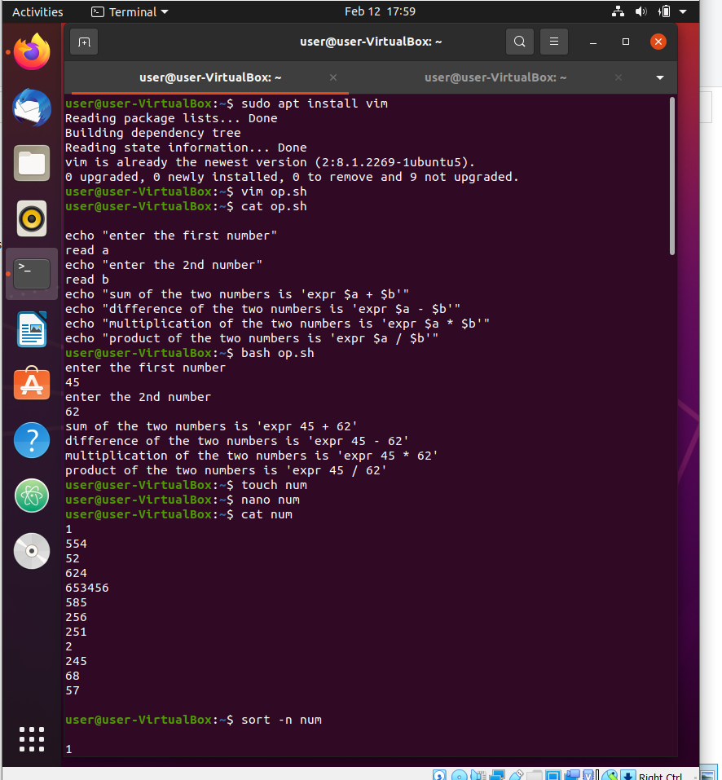
sudo apt install vim- Vim is a text editor that is upwards compactable to vi. It can be used to edit all kinds of plain texts in ubuntu. This command installs all the basic packages in ubuntu.
vim file.sh- creats a file with the desired name
cat file.sh- displays the contents of the vi file
bash file.sh- this command executes the vi scripts

Slide 3
touch file- to create a new file
nano file- to insert the contents of the file
cat file- to display the contents of the file mentioned
sort -n file- this commad help to sort the numbers in the accending order

Slide 4
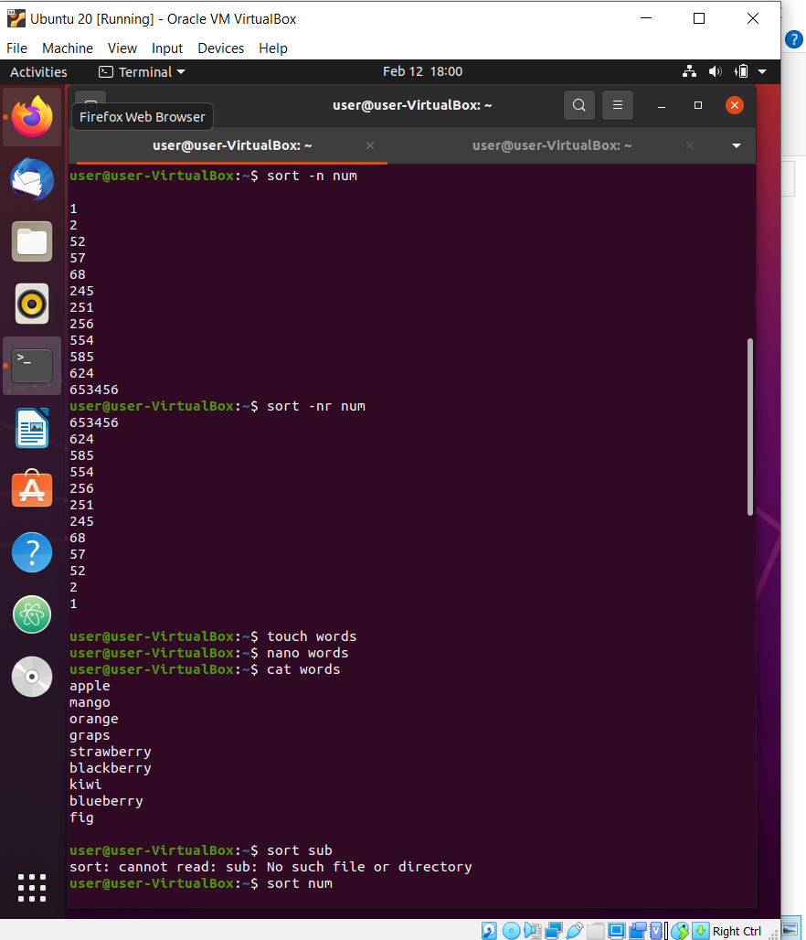
sort -n file- this command help to sort numbers
sort -nr file- this command help to sort numbers in reverse order
touch file- this couch command can also be used to create a file with strings in it.
nano file- nano command is same for both the cases.
sort file name- to sort the words in alphabetic order

Slide 5
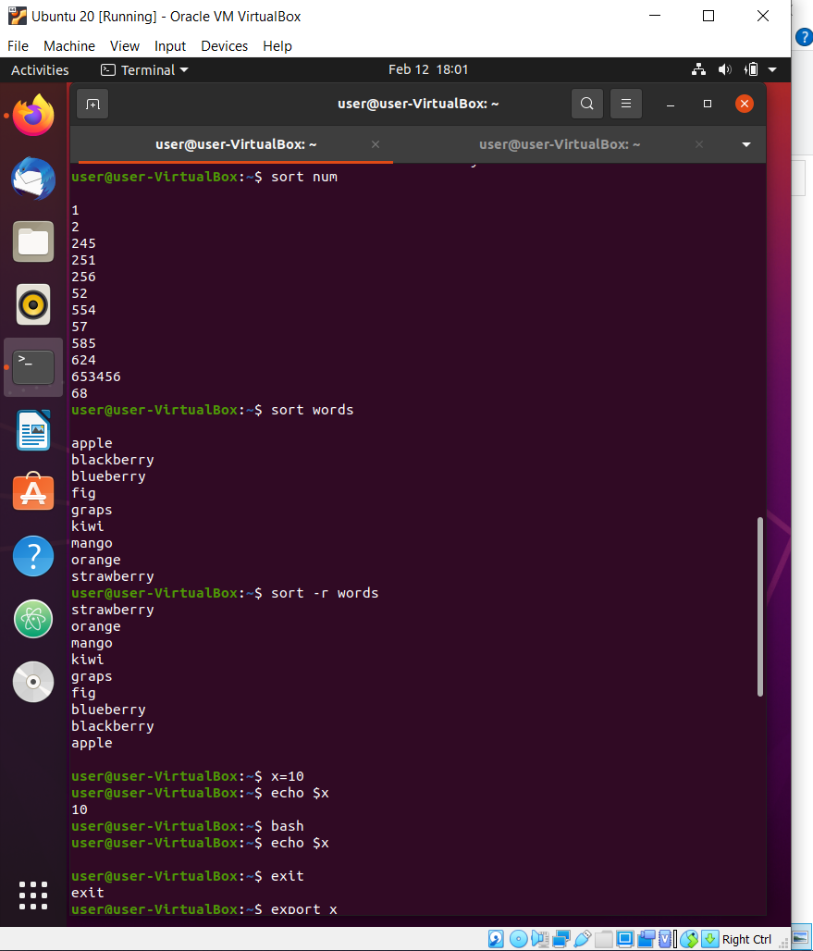
sort -r file- it is used to sort the words in reverse order
x=10 : here is assigning command,it is used to assign a particular value to a variable
export: Exports the value from one shell to another shell.
exit: Exit from the current shell.
echo $x: Reads the value from x variable and displays it.
bash: Shell name

Slide 6
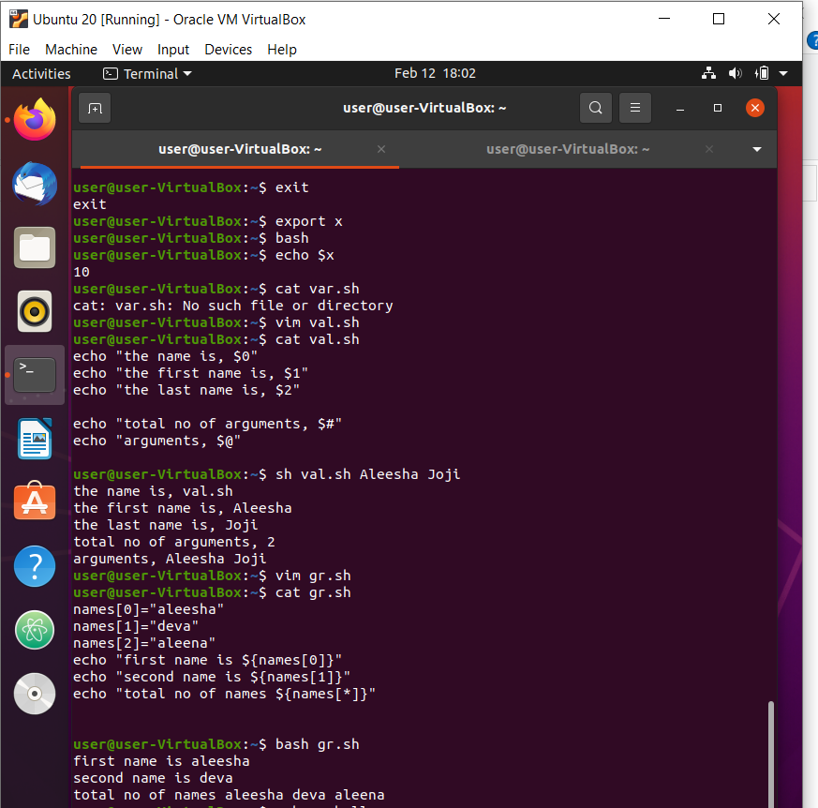
$0: Displays the file name of the current script.
$n: Displays the argument in the corresponding position.
$#: Shows the number of arguments in the script.
$@: Shows all the arguments individually double quoted.
$?: The exit status of the last command executed.

Slide 7
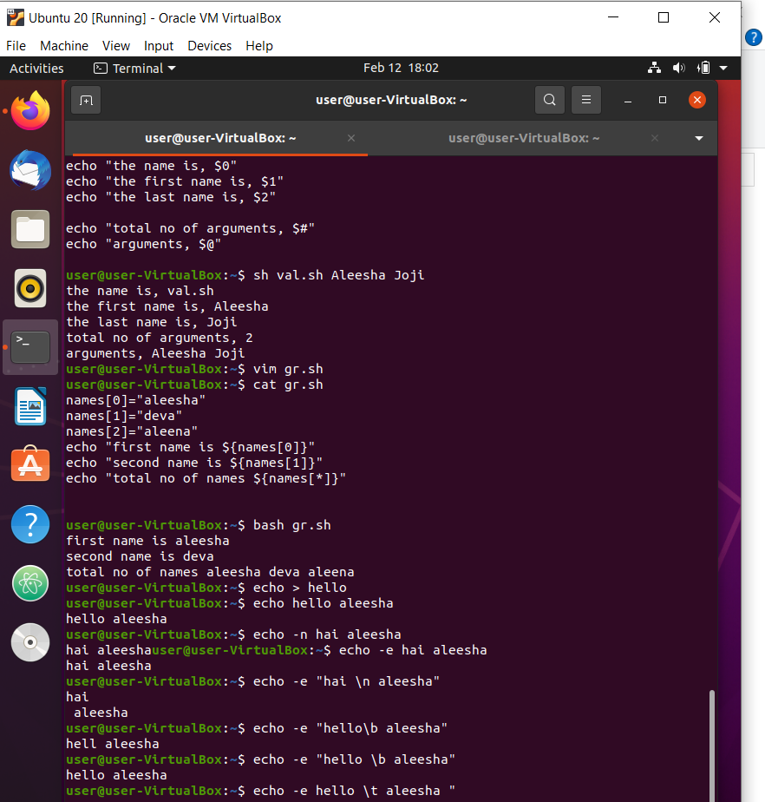
-n: Gives the output without a new line.
-e: Allows to use backslash escapes.
\b: Removes the space between text.
\n: Displays the text in different lines.
\t: Allows a horizontal tab.
\v: Allows a vertical tab.

Slide 8
THANK YOU

